Slide 1
Democracy- Chapter 1
Traces of democracy found in Greek, Mesopotamian, Indian civilizations.

Slide 2
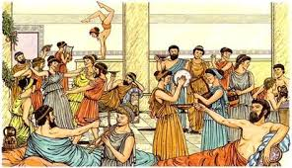
Direct form of democracy in Athens(Greece)
The citizens not only elected their politicians but also punished them by writing the name on a piece of ‘pottery’ called OSTRAKON.

Slide 3
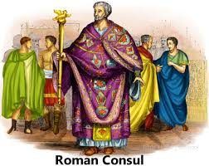
‘Elected ‘ consuls – form of democracy in Rome
The Roman assembly was called a Senate and elected members were called Consuls. Initially they were from amongst the Nobles, later , however the people won the right to elect their representatives as well as stand for Consulship.

Slide 4
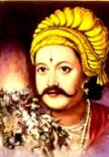
India-Elected ‘king’ – Gopala of the Pala dynasty
In 750 AD, a king was elected in Bengal. He started the Pala dynasty.

Slide 5
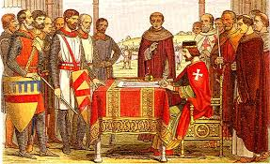
England- Magna Carta(1215)
The Magna Cart was created in England in 1215. This document represented the first time a written set of rules was dictated to a King of England by the subjects of the country, and led to the type of constitutional law we see today.

Slide 6
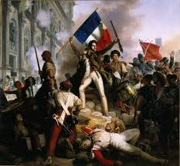
French Revolution-1799
Cause-the failure of King Louis XVI to properly manage his nation's finances and institute needed reforms. Wars, famine, and depression caused the population of Paris and France at large to unseat their leader and claim the country for themselves in the name of liberty.

Slide 7
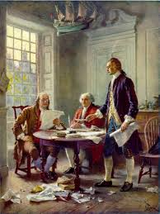
USA- Declaration of Independence(1788)
This document was highly significant because it announced the decision of the United States to become independent and free from British rule. More importantly, it explained

Slide 8
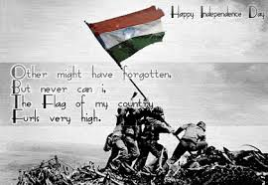
India- Independence from British Monarchs(1947)
India attained Independence on August 15th 1947, after a great political and social struggle. The British had ruled over India for a considerable period of time. Their initial intentions were to carry out trade in India, but in due course of time they developed political and administrative ambitions.

Slide 9
History of Democracy
Hope you all have understood the way various
Countries and their people fought to gain their rights……movement towards democracy. There were many more…..

Slide 10

Best of Luck

